Slide 1
Kubernetes Networking with Services

Slide 2

Overview
Theory
Create a Service Imperatively Create a Service Declaratively
Create an Internet LoadBalancer Service Recap

Slide 3
Kubernetes Service Theory

Slide 4
$ cd getting-started-k8s/Pods
$ kubectl apply –f pod.yml
Getting the Code
You’ll need git installed, and kubectl configured to talk to your K8s cluster.

Slide 5
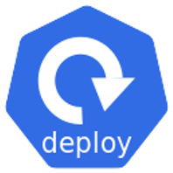















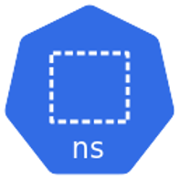


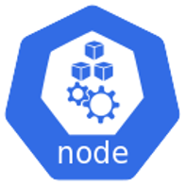


{}
api
API
WORKLOADS APIS
apps
storage.k8s.io
core ‘’
v1
v1
v1
v1
v1
v1
networking.k8s.io
v1
v1
apiserver{}
v1
v1
v1
batch
v1beta1 v1
. . .
v1
v1
v1
v1
v1beta1
v1
v1
v1

Slide 6



Slide 7
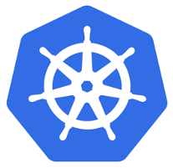
K8s cluster
<YAML>
POST (HTTPS)
{}
api srv

Slide 8







pod
Unreliable Pod IPs

Slide 9
pod
Unreliable Pod IPs

Slide 10


pod

Slide 11
Front end
pod

Slide 12
pod
Front end
Back end

Slide 13

pod
Name and IP
Load balancing

Slide 14
Name and IP
pod
Load balancing
Abstraction

Slide 15





pod
DNS name Registered with cluster DNS All Pods can resolve
ClusterIP Assigned by K8s
Name and IP
Load balancing
Labels
Abstraction

Slide 16

pod
DNS name Registered with cluster DNS All Pods can resolve
ClusterIP Assigned by K8s
Name and IP
Load balancing
Labels
Abstraction

Slide 17
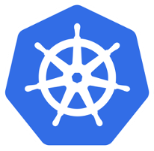






K8s cluster
Cluster DNS
dns
stag-svc = 10.2.1.88
sky-svc = 10.0.0.40
...
app1-svc 10.0.0.61
App1

Slide 18
K8s cluster
Cluster DNS
dns
stag-svc = 10.2.1.88
sky-svc = 10.0.0.40
app1-svc = 10.0.0.61
...
app1-svc 10.0.0.61
App1

Slide 19

K8s cluster
App2
Cluster DNS
dns
stag-svc = 10.2.1.88
sky-svc = 10.0.0.40
app1-svc = 10.0.0.61
...
app1-svc 10.0.0.61
App1

Slide 20
K8s cluster
App2
Resolve app1-svc
Cluster DNS
dns
stag-svc = 10.2.1.88
sky-svc = 10.0.0.40
app1-svc = 10.0.0.61
...
app1-svc 10.0.0.61
App1

Slide 21
K8s cluster
App2
Cluster DNS
dns
stag-svc = 10.2.1.88
sky-svc = 10.0.0.40
app1-svc = 10.0.0.61
...
app1-svc 10.0.0.61
App1

Slide 22
K8s cluster
App2
10.0.0.61
Cluster DNS
dns
stag-svc = 10.2.1.88
sky-svc = 10.0.0.40
app1-svc = 10.0.0.61
...
app1-svc 10.0.0.61
App1

Slide 23
K8s cluster
App2
Cluster DNS
dns
stag-svc = 10.2.1.88
sky-svc = 10.0.0.40
app1-svc = 10.0.0.61
...
app1-svc 10.0.0.61
App1

Slide 24
K8s cluster
App2
Cluster DNS
dns
stag-svc = 10.2.1.88
sky-svc = 10.0.0.40
app1-svc = 10.0.0.61
...
app1-svc 10.0.0.61
App1

Slide 25





K8s cluster
app1-svc 10.0.0.61
Port 30001
App1

Slide 26
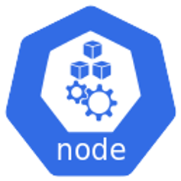
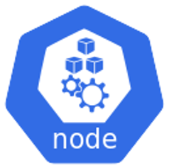
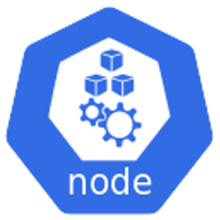

NodePort
30001
30001
30001
30001
K8s cluster
app1-svc 10.0.0.61
Port 30001
App1

Slide 27


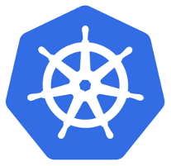




LoadBalancer
apiVersion: v1 kind: Service metadata:
name: ps-lb spec:
type: LoadBalancer
ports:
- port: 80
targetPort: 8080 selector:
app: web
K8s cluster
App1

Slide 28
Up Next:
Creating a Service (the imperative way)

Slide 29
Creating a Service (the imperative way)

Slide 30


Unreliable
dns
External access
Internal access

Slide 31
Up Next:
Creating a Service (the declarative way)

Slide 32
Creating a Service (the declarative way)

Slide 33
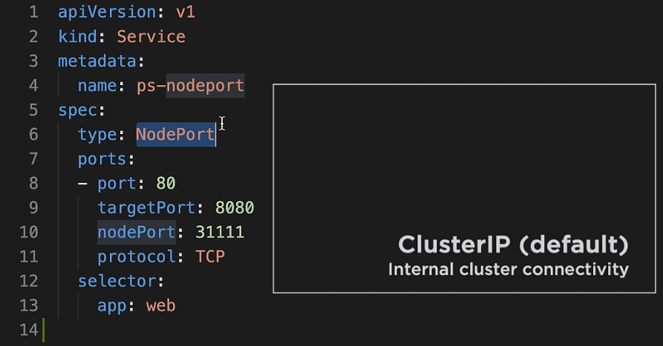

Slide 34
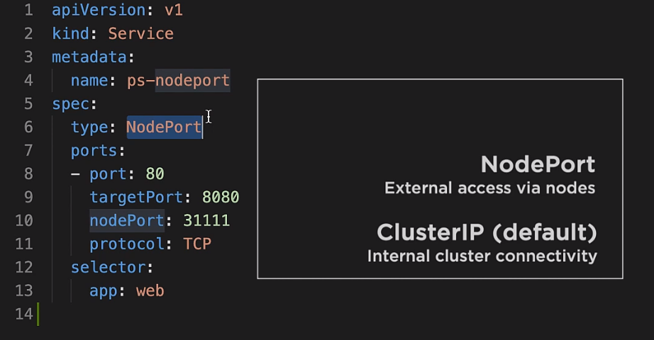

Slide 35
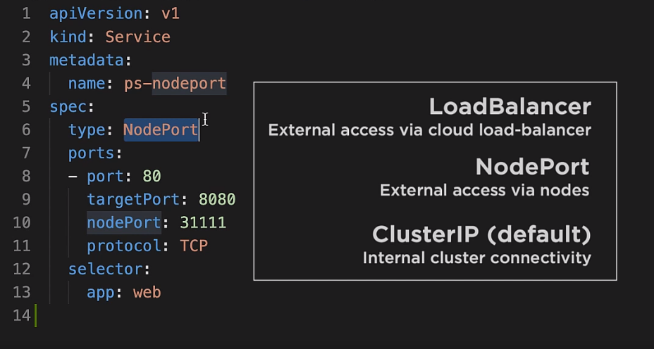

Slide 36
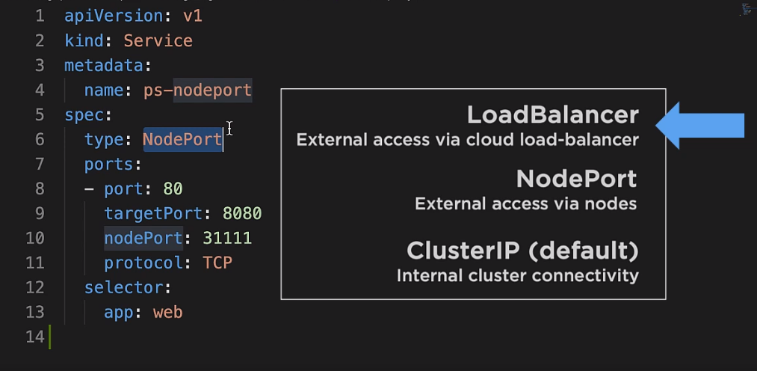

Slide 37
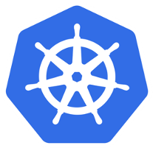



NodePort
31111
31111
31111
31111
80
ClusterIP:80 NodePort: 31111
8080
app:8080

Slide 38
LoadBalancer
External access via cloud load-balancer
NodePort
External access via nodes
ClusterIP (default)
Internal cluster connectivity

Slide 39
Creating Internet LoadBalancer Services

Slide 40

Only works on supported platforms and supported load balancers

Slide 41
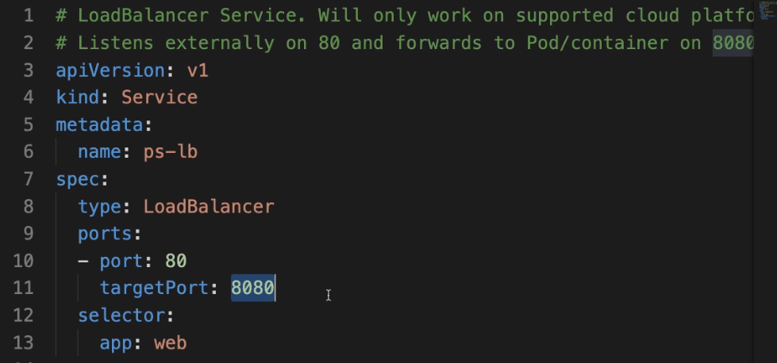

Slide 42
Up Next: Services Recap

Slide 43
Recap

Slide 44

Stable Networking
Reliable networking for a set of Pods
Abstraction
Hides the unreliable nature of Pods

Slide 45




pod
Name, IP & port
Stable
Load balancing

Slide 46
Name, IP & port
pod
Stable
Load balancing
Abstraction

Slide 47





Name, IP & port
pod
Stable
Load balancing
ClusterIP (default)
Internal cluster connectivity
Abstraction

Slide 48
Name, IP & port
pod
Stable
NodePort
External access via nodes
Load balancing
ClusterIP (default)
Internal cluster connectivity
Abstraction

Slide 49
LoadBalancer
External access via cloud load-balancer
pod
Name, IP & port
Stable
NodePort
External access via nodes
Load balancing
ClusterIP (default)
Internal cluster connectivity
Abstraction

Slide 50
Up Next:
Kubernetes Deployments

